Slide 1
Flow Visualization
Problems and Concepts
Elementary Methods Characteristic Curves
Geometry-Based Methods

Slide 2
Flow Visualization: Problems and Concepts
Flow data appear in a variety of applications, i.e.
Simulation / computation of flow around cars, planes, ships
atmospheric flow for weather forecast
studying flow in bottling / filling devices
There are different aims, such as:
perceiving and understanding physical phenomena
modeling of flow processes
optimization in technical design
search for damage reasons

Slide 3
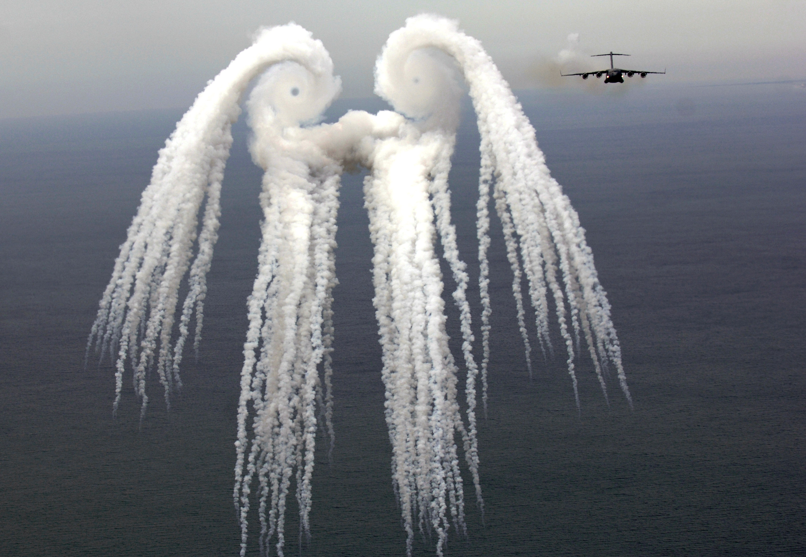
Smoke angel
A C-17 Globemaster III from the 14th Airlift Squadron, Charleston Air Force Base, S.C. flies off after releasing flares over the Atlantic Ocean near Charleston, S.C., during a training mission on Tuesday, May 16, 2006. The "smoke angel" is caused by the vortex from the engines. (U.S. Air Force photo/Tech. Sgt. Russell E. Cooley IV)

Slide 4
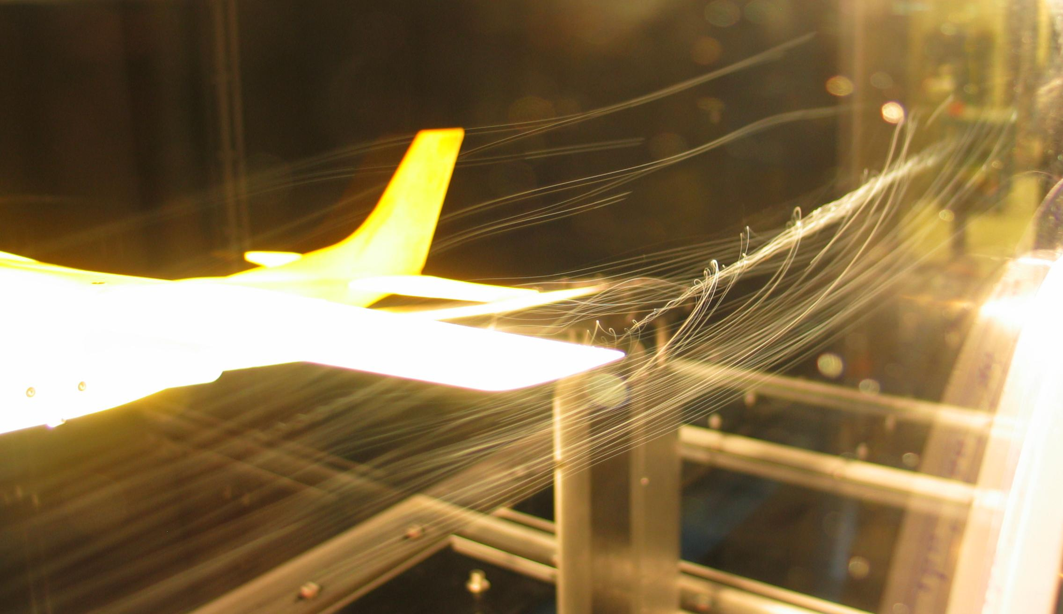
Flow Visualization: Problems and Concepts
A wind tunnel model of a Cessna 182 showing a wingtip vortex. Tested in the RPI (Rensselaer Polytechnic Institute) Subsonic Wind Tunnel. By Ben FrantzDale (2007).

Slide 5
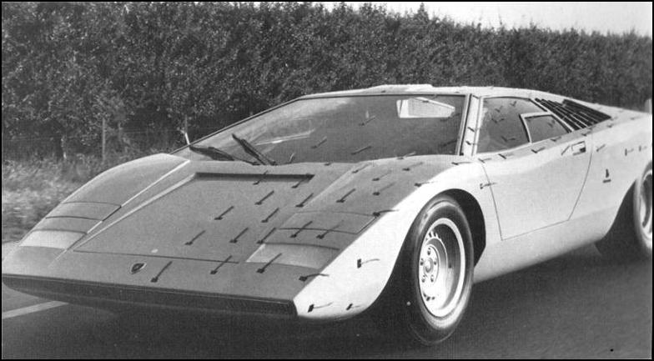
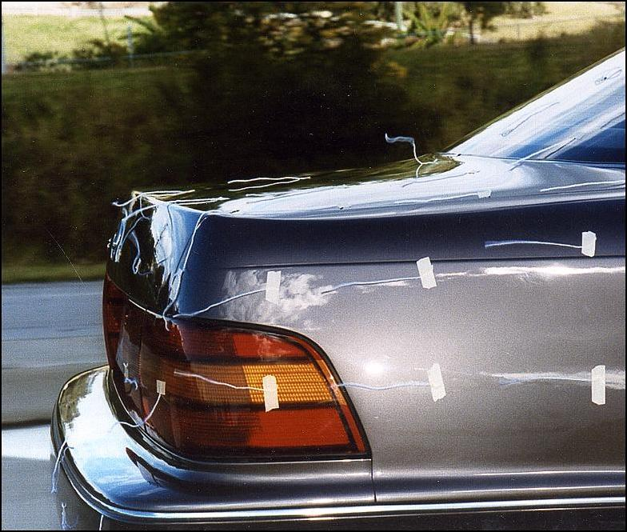
Flow Visualization: Problems and Concepts
http://autospeed.com/cms/A_108677/article.html
http://autospeed.com/cms/A_108677/article.html
wool tufts
Notes:
5

Slide 6
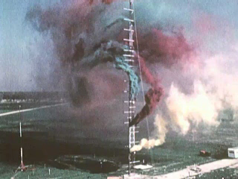
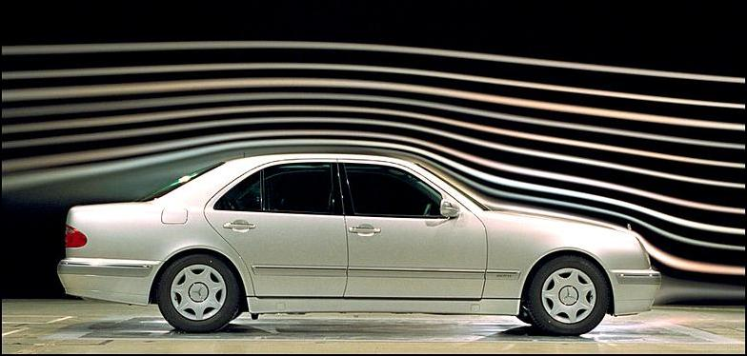
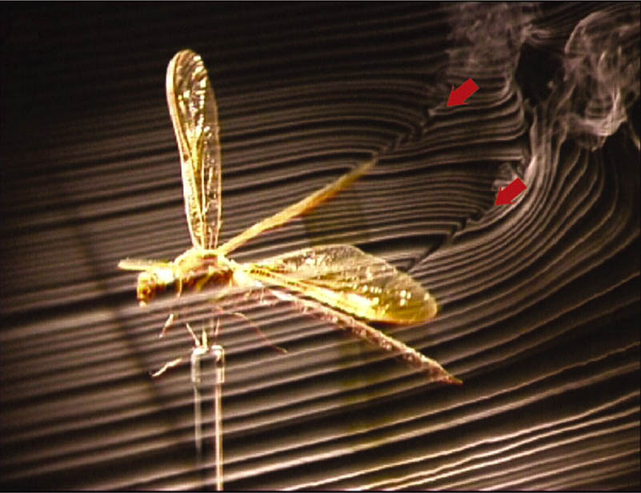
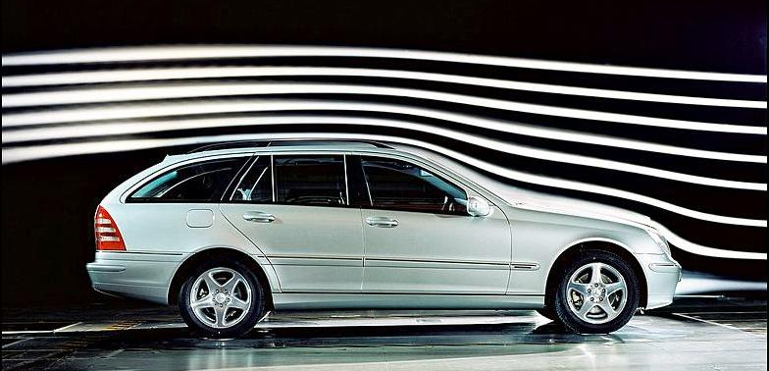
Flow Visualization: Problems and Concepts
smoke injection
smoke nozzles
http://autospeed.com/cms/A_108677/article.html
[NASA, J. Exp. Biol.]
http://autospeed.com/cms/A_108677/article.html
smoke nozzles

Slide 7
Flow Visualization: Problems and Concepts
Smoke injection
A. L. R. Thomas, G. K. Taylor, R. B. Srygley, R. L. Nudds, and R. J.
Bomphrey. Dragonfly flight: free-flight and tethered flow visualizations
reveal a diverse array of unsteady lift-generating mechanisms, controlled
primarily via angle of attack. J Exp Biol, 207(24):4299–4323, 2004.
Notes:
7

Slide 8
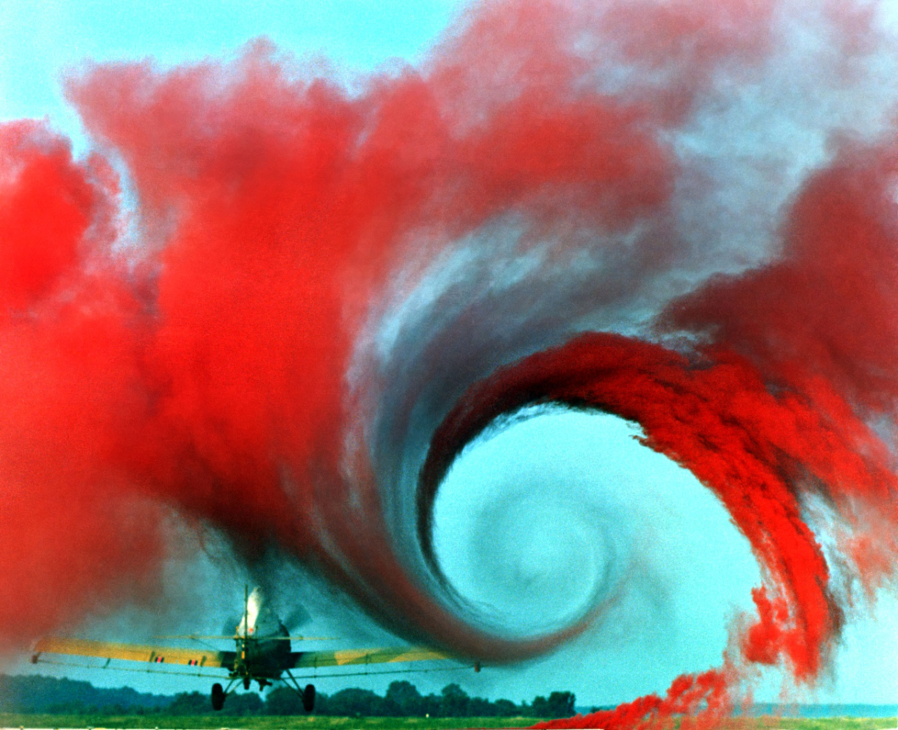
Flow Visualization: Problems and Concepts
http://de.wikipedia.org/wiki/Bild:Airplane_vortex_edit.jpg
Notes:
8

Slide 9
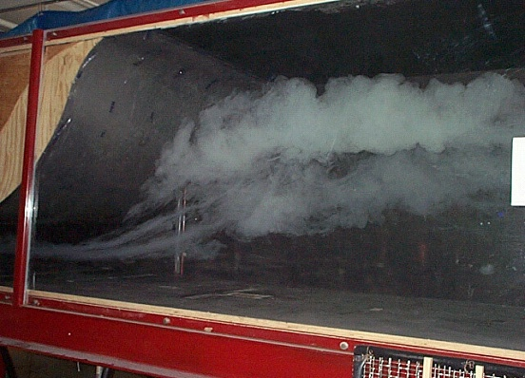
Flow Visualization: Problems and Concepts
Smoke injection
http://www-me.ccny.cuny.edu/research/aerolab/facilities/images/wt2.jpg
Notes:
9

Slide 10
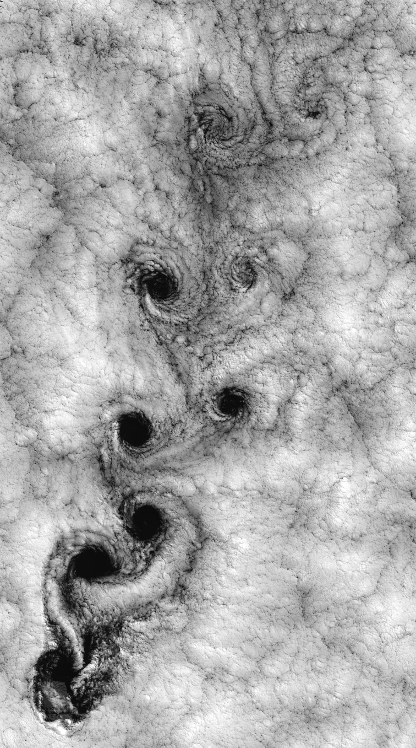
Flow Visualization: Problems and Concepts
Clouds (satellite image)
Juan Fernandez Islands
http://de.wikipedia.org/wiki/Bild:Vortex-street-1.jpg
Notes:
10

Slide 11
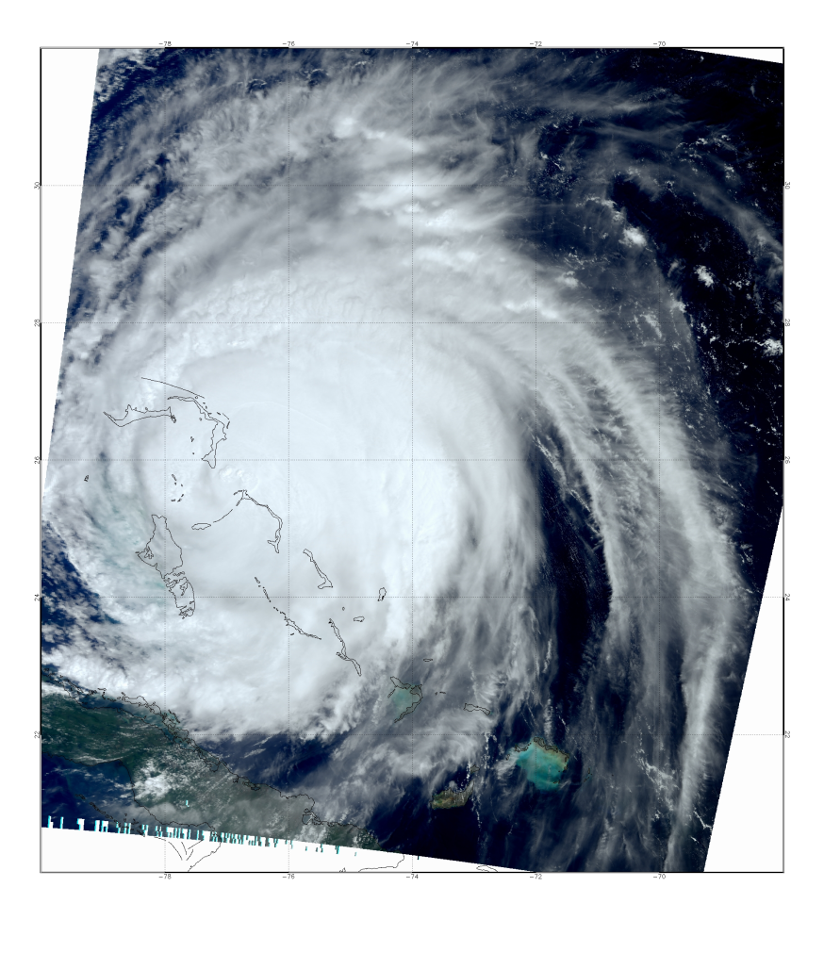
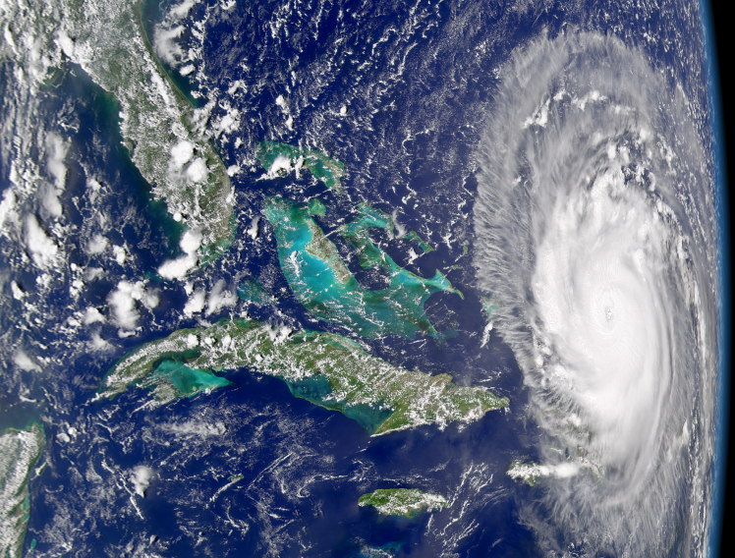
Flow Visualization: Problems and Concepts
Clouds (satellite image)
http://daac.gsfc.nasa.gov/gallery/frances/
Notes:
11

Slide 12
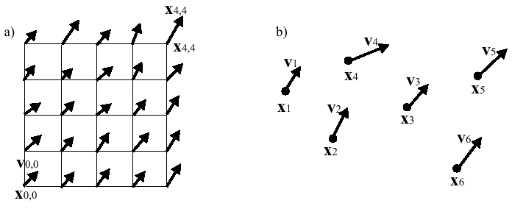
Flow Visualization: Problems and Concepts
Flow data:
vector data on a 2D or 3D grid
in addition scalar data may be defined per grid point
( E^{V2}_{[2]} , E^{V3}_{[3]})
flow data; a) on regular grid; b) scattered flow data

Slide 13
Flow Visualization: Problems and Concepts
Obtaining flow data:
by measurement:
sensors at certain sample points of a fluid/gas in motion give flow velocity at these points
optical methods: PIV
by simulation: solving the Navier/Stokes equations

Slide 14
Flow Visualization: Problems and Concepts
Flow data is converted to a vector field by interpolation of the vectors inside the cells.
simulation / measurement
flow data
interpolation
vector field
visualization

Slide 15


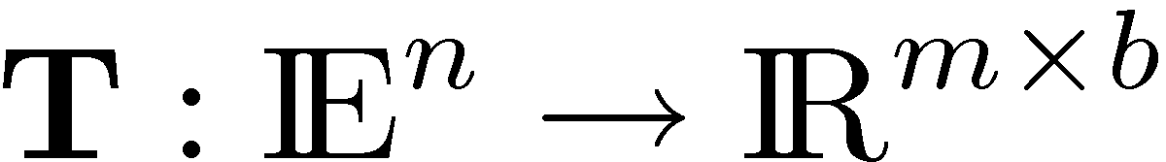
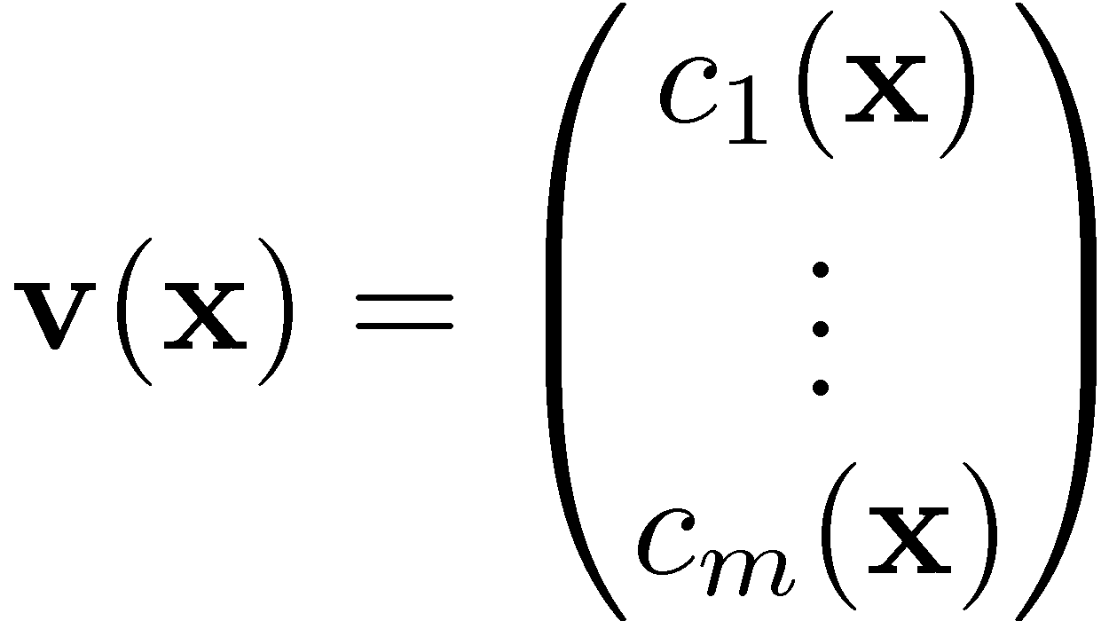
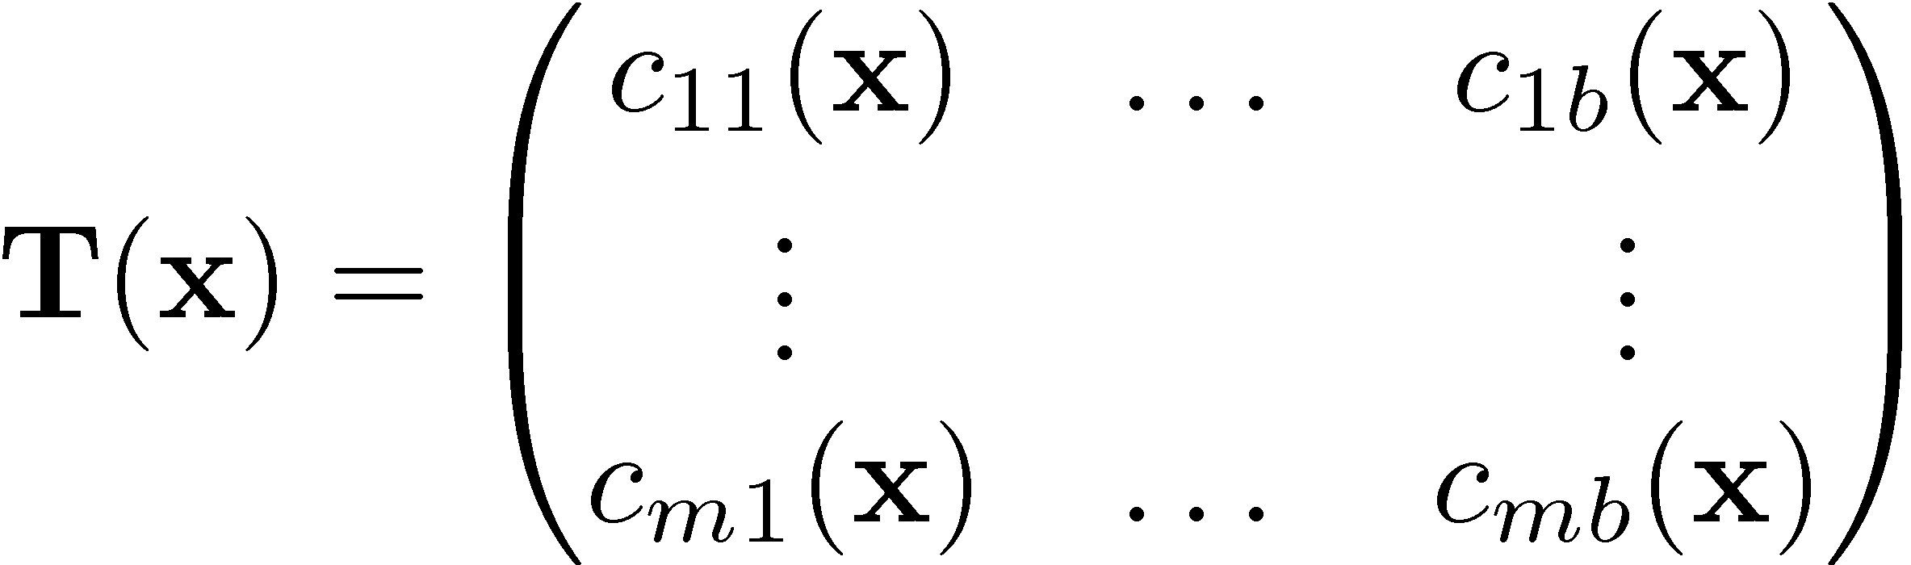
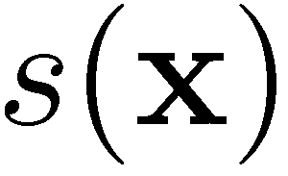

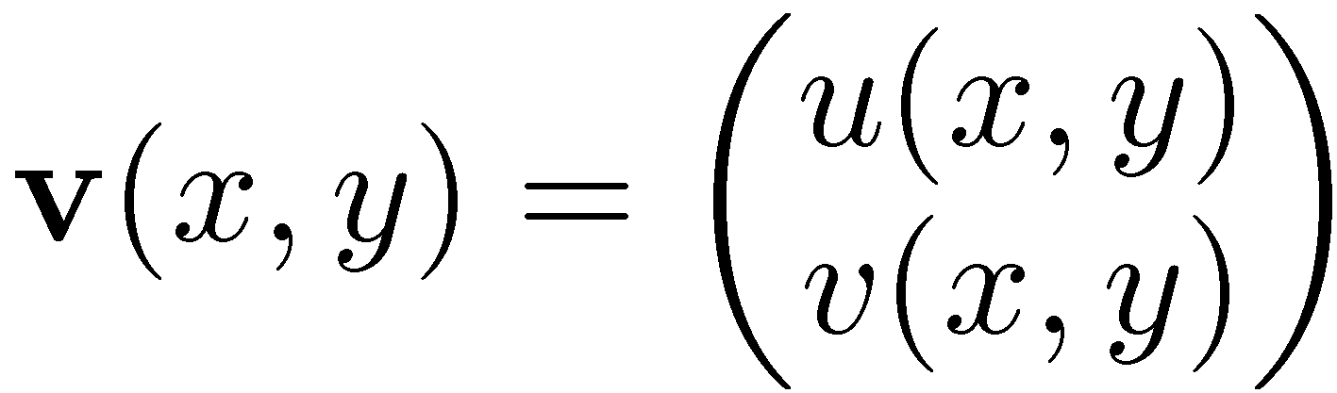
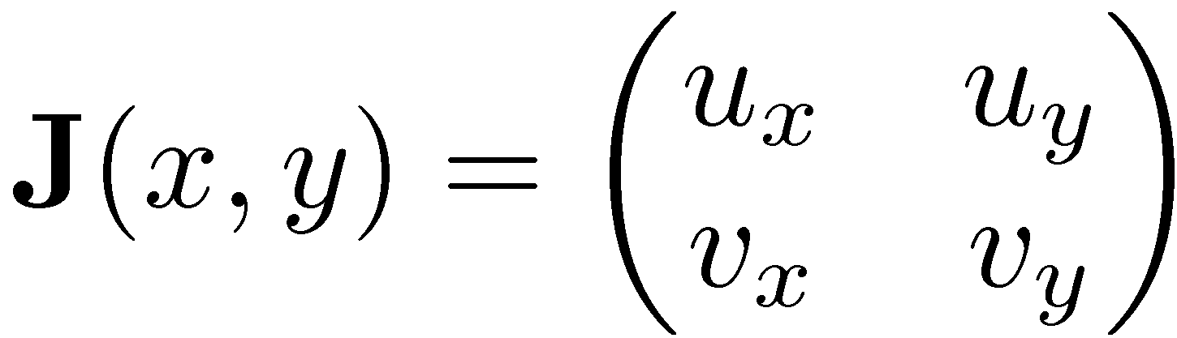
Flow Visualization: Problems and Concepts
scalar field
vector field
tensor field
2D vector field
Jacobian of 2D vector field

Slide 16
Flow Visualization: Problems and Concepts
vector field
tensor field
Supposed to be continuous and differentiable. This means we can compute its partial differentials and write them into the 2x2 matrix:
2D vector field
Jacobian of 2D vector field

Slide 17
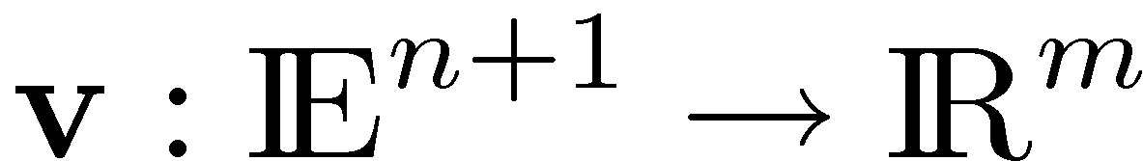
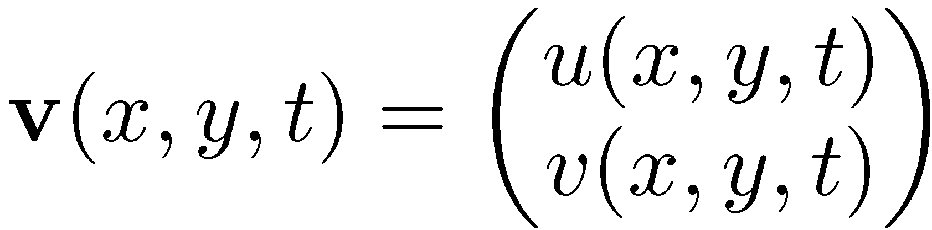
Flow Visualization: Problems and Concepts
vector field
parameter-independent
steady vector field
one-parameter-dependent
unsteady vector field

Slide 18
Flow Visualization
Visualization methods for flow fields

Slide 19
Flow Visualization: Problems and Concepts
orientation
direction
length / velocity
information encoded in a vector
vector field visualization method:
which of these aspects are shown?

Slide 20
Flow Visualization: Visualization Methods
Methods for flow data:
Elementary (direct) methods: show properties of selected points
Geometry-Based Methods: integrated lines, surfaces
Image-Based Methods: use textures to show the flow
Feature extraction: focus on specific aspects/features of the flow
Topology-based flow visualization
Further methods
Main problems for visualization:
spatial complexity
dimensionality of the data

Slide 21
Flow Visualization
Elementary (Direct) Methods

Slide 22
Flow Visualization: Elementary Methods
Elementary Methods:
Present the complete data set at low level of abstraction
Mapping is direct, without complex conversions or extractions
3 main representations:
color coding
arrow plots
icons
➔ very frequently used
Notes:
22

Slide 23
Flow Visualization: Elementary Methods
Color Coding:
Extract scalar field from vector field (i.e. magnitude, curvature, pressure, temperature)
2D: direct color coding to visualize them
same for slices or boundary surfaces in 3D
3D ➔ volume visualization (FlowVis ➔ VolVis)
➔ loss of information

Slide 24
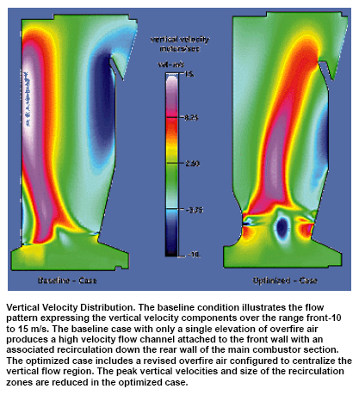
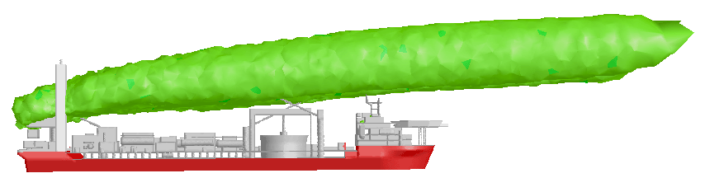
Flow Visualization: Elementary Methods
Examples for Color Coding:
www.fluent.com

Slide 25
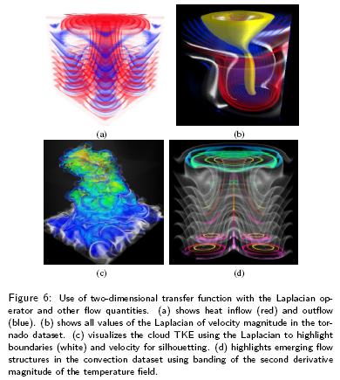
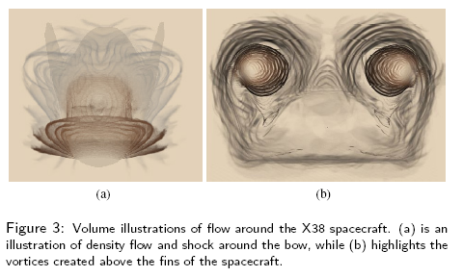
Flow Visualization: Elementary Methods
Volume illustration for flow visualization [Svakine et al 05]

Slide 26
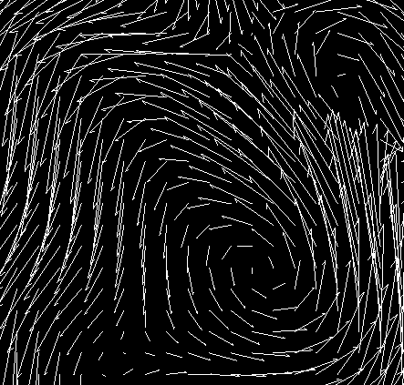
Flow Visualization: Elementary Methods
Arrow plots:
also called hedgehog plots
represent velocity as arrows at regular locations, e.g., place arrows at grid points
➔ overloading possible
arrows: (scaled) unit length or encode magnitude
well-established for 2D

Slide 27
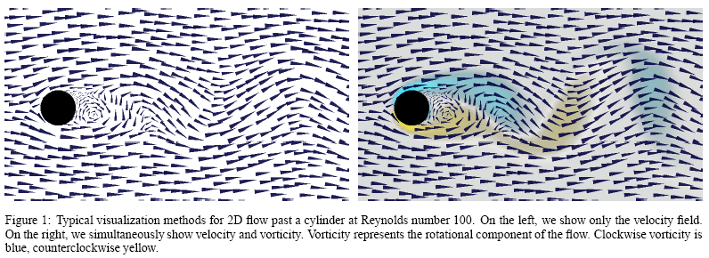
Flow Visualization: Elementary Methods
[Kirby et al 99]: multiple values of 2d flow data by layering concept related to painting process of artists

Slide 28
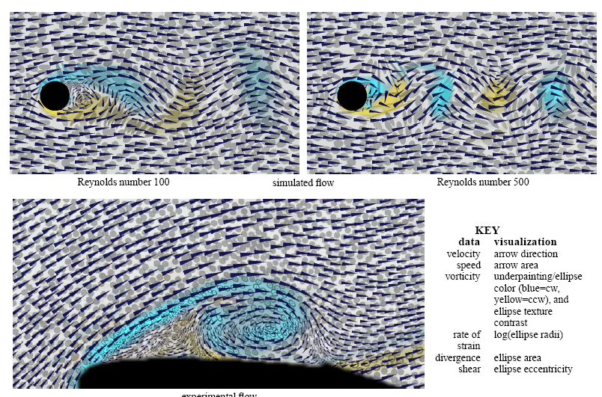
Flow Visualization: Elementary Methods

Slide 29
Flow Visualization: Elementary Methods
3D arrow plots:
Occlusion problem ➔ careful seeding
Ambiguity problem
Solutions:
3D icons (cylinder + cone)
Highlight parts of error plot which points into a user defined direction

Slide 30
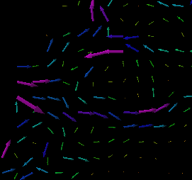
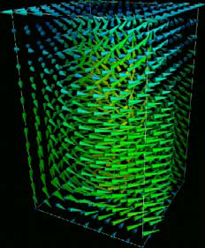
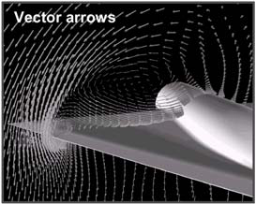
Flow Visualization: Elementary Methods

Slide 31
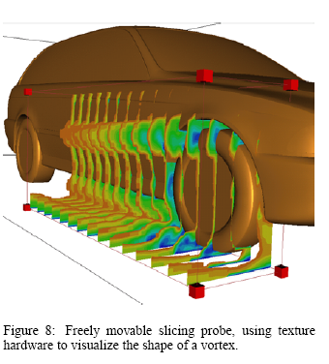
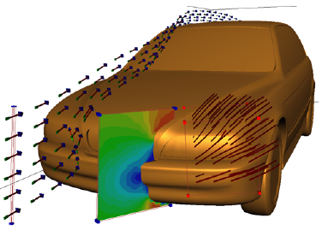
Flow Visualization: Elementary Methods
[Schulz et al 99]

Slide 32
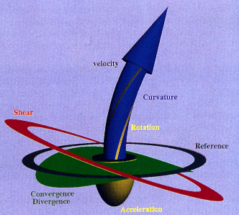
Flow Visualization: Elementary Methods
Icons:
Place icon at selected locations and encode different values of the flow
Seeding strategy necessary (usually interactive)
Example: probe for local flow visualization [de Leeuw, van Wijk 93]

Slide 33
Flow Visualization: Elementary Methods
Show in Amira:
Color Coding
Arrow plots
3D Vectors
Local Probe

Slide 34
Flow Visualization
Characteristic Curves (Integral Curves)
very important

Slide 35
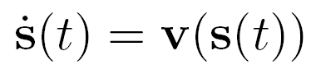
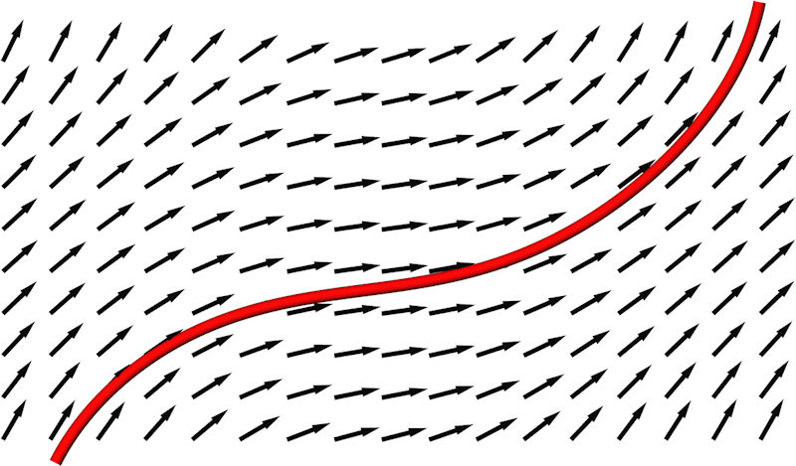
Flow Visualization: Characteristic Curves
very important
A tangent curve s(t) of the vector field v is a curve in E^{2/3} with the property:
for any t of the domain of s.
Interpretation: path of a massless particle in a flow described by v
denotes the tangent vectors of s(t)

Slide 36
Flow Visualization: Characteristic Curves
very important
Properties of tangent curves:
Tangent curves do not intersect each other (except for critical points of v) .
Given a point in the vector field v, there is one and only one tangent curve through it (except for critical points of v)
A parametric description of stream lines is usually not possible.
But it is possible for linear vector fields.

Slide 37
Flow Visualization: Characteristic Curves
very important
Based on tangent curves, we define 4 types of characteristic curves of a vector field
concept of
tangent curves
concept of
characteristic curves
stream lines
path lines
streak lines
time lines

Slide 38
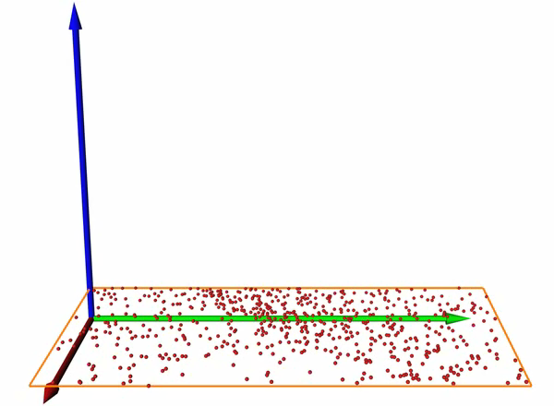
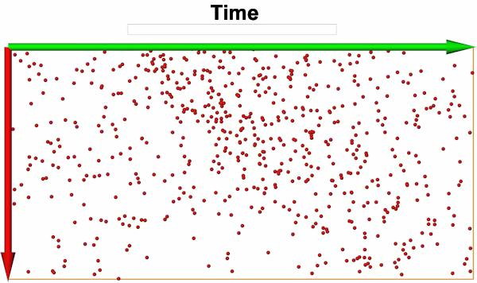
2D time-dependent vector field
particle visualization

Slide 39
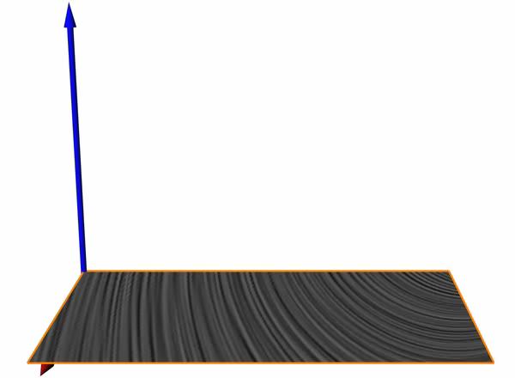
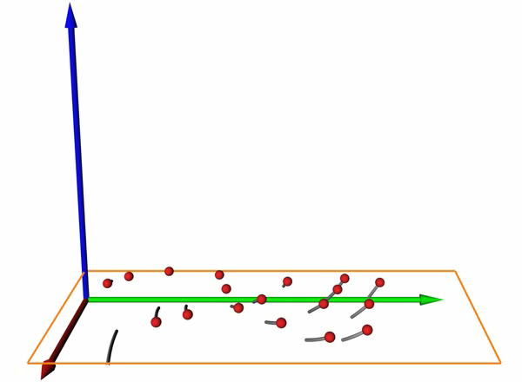
stream lines
path lines
curve parallel to the vector field in each point for a fixed time
describes motion of a massless particle in an steady flow field
curve parallel to the vector field in each point over time
describes motion of a massless particle in an unsteady flow field

Slide 40
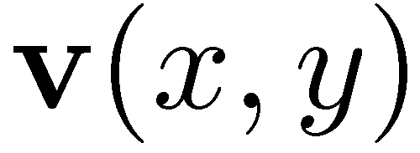
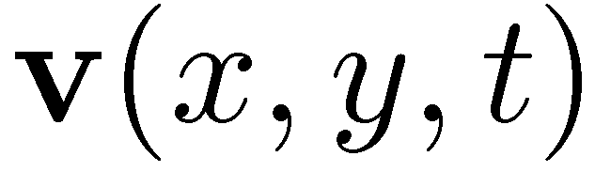
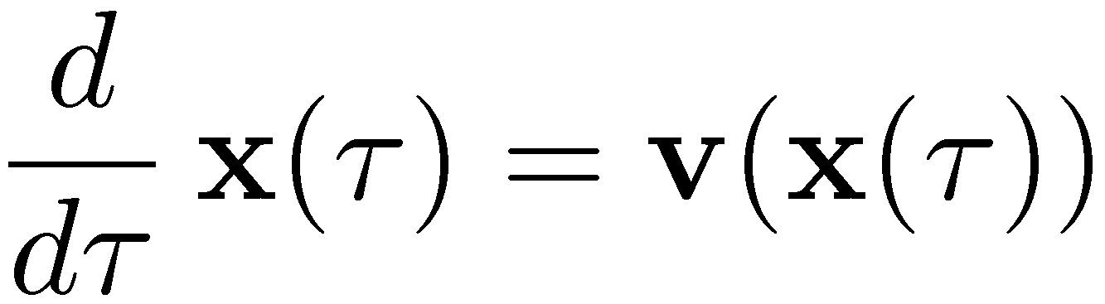
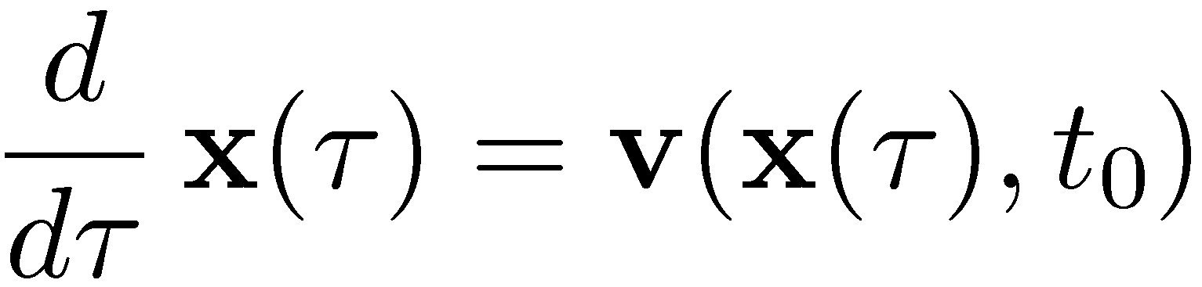
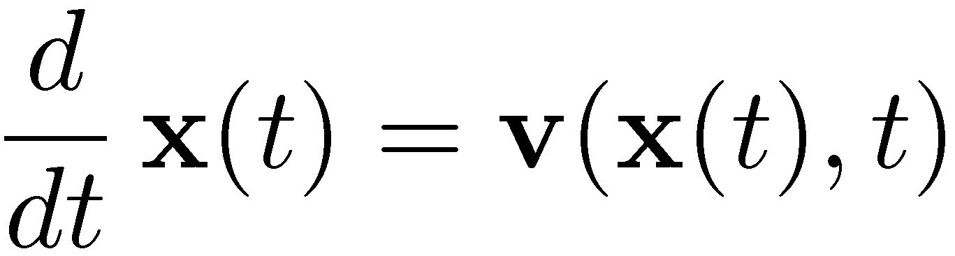


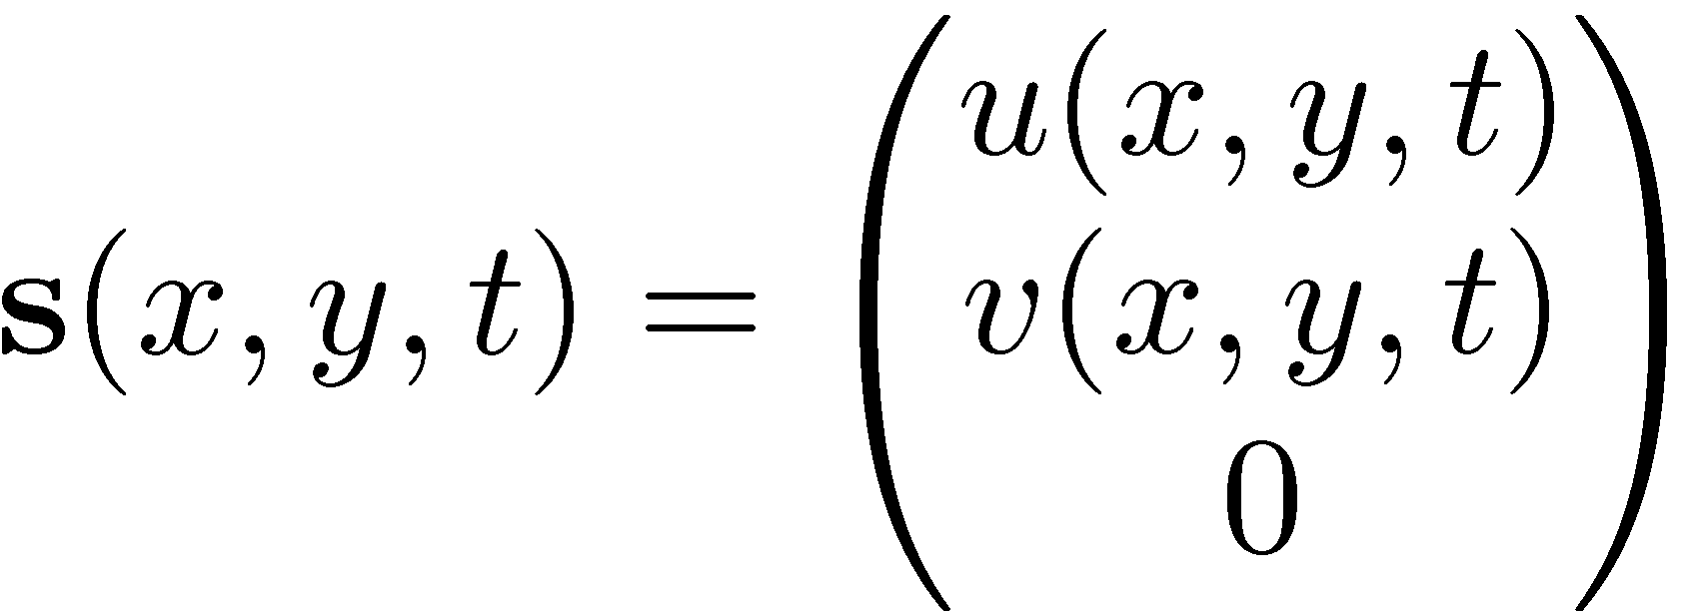
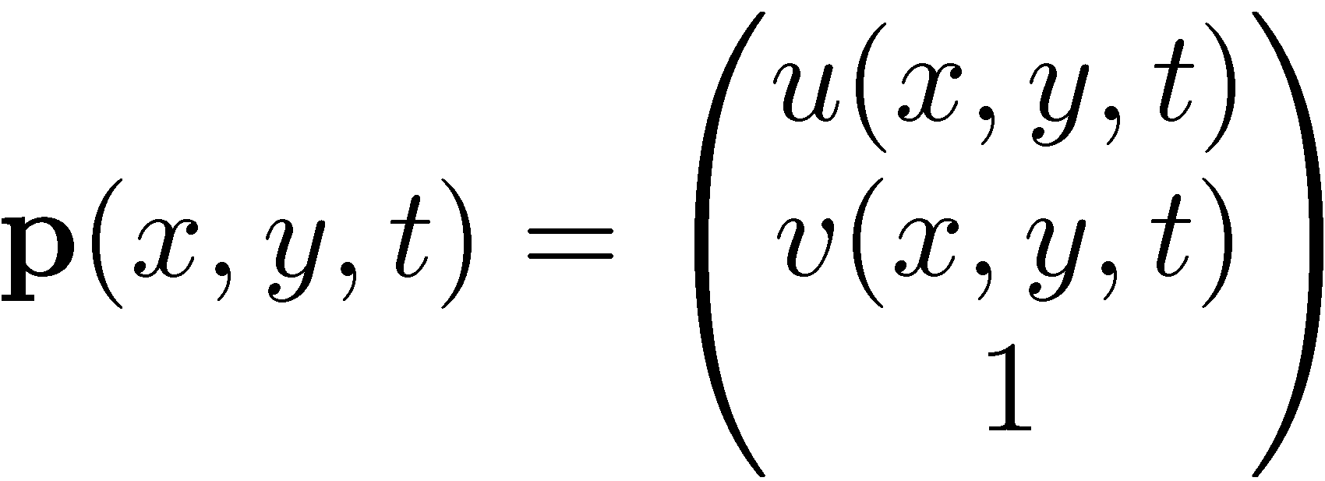
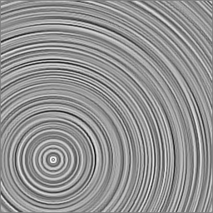
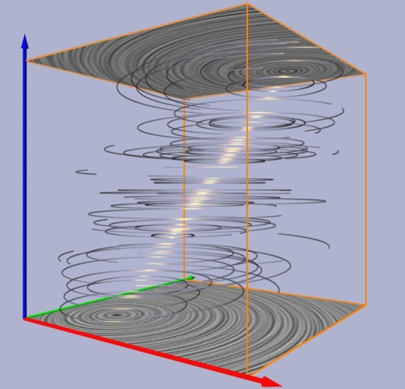

Flow Visualization: Characteristic Curves
very important
steady vector field
unsteady vector field
stream lines
stream lines
path lines

Slide 41



Flow Visualization: Characteristic Curves
very important
steady vector field
unsteady vector field
2D
nD unsteady vector field ➔ (n+1)D steady vector field
3D

Slide 42

streak line
location of all particles set out at a fixed point at different times

Slide 43



stream lines
path lines
streak lines

Slide 44

time line
location of all particles set out on a certain line at a fixed time

Slide 45

time line
location of all particles set out on a certain line at a fixed time

Slide 46


stream lines
path lines
streak lines
time lines

Slide 47
Flow Visualization: Characteristic Curves
very important
Characteristic curves of a vector field:
Stream line: curve tangential to the vector field in each point for a fixed time
Path line: describes the motion of a particle over time in an unsteady flow field
Streak line: location of all particles set out at a fixed point at different times
Time line: location of all particles set out on a certain line at a fixed time

Slide 48
Flow Visualization: Characteristic Curves
very important
Stream and Path lines:
Through all non-critical points (x,t) in space-time there is exactly one stream/path line passing through it.
Streak and Time lines:
Many streak/time lines through every point (of the spatial domain)
➔ makes it difficult to describe streak/time lines as tangent curves of some vector field
But it is possible. We may discuss it in a later session.
Stream, Path, and Streak lines coincide in a steady vector field.

Slide 49








Flow Visualization: Characteristic Curves
Example:
v(x,t) = (1-t) + t
stream path
streak time
Show in Amira

Slide 50

Flow Visualization: Characteristic Curves
Characteristic curves of a vector field:
Stream line: P₀, P₁, P₂
Path line: P₀, P₁, P₄
Streak line: P₀, P₃, P₄

Slide 51




Flow Visualization: Characteristic Curves
A time-dependent (unsteady) vector field

Slide 52
Flow Visualization: Characteristic Curves
Stream line
curve tangential to the vector field in each point for a fixed time

Slide 53
Flow Visualization: Characteristic Curves
Stream line
curve tangential to the vector field in each point for a fixed time
solution

Slide 54
Flow Visualization: Characteristic Curves
Path line motion of a particle over time in an unsteady flow field

Slide 55
Flow Visualization: Characteristic Curves
Path line motion of a particle over time in an unsteady flow field

Slide 56
Flow Visualization: Characteristic Curves
Path line motion of a particle over time in an unsteady flow field
solution

Slide 57
Flow Visualization: Characteristic Curves
Streak line
location of all particles set out at a fixed point at different times

Slide 58
Flow Visualization: Characteristic Curves
Streak line
location of all particles set out at a fixed point at different times
solution
particle started at t=0
particle started at t=2
particle started at t=1
particle “started” at t=3

Slide 59
Flow Visualization
Geometry-Based Methods
(integration-based)

Slide 60
Flow Visualization: Geometry-Based Methods
Geometry-based Methods:
Idea: extract geometric objects for which the shape is directly related to the flow
Examples:
Stream lines
Streak lines, path lines, time lines
Stream ribbons
Stream surfaces
Streak surfaces, path surfaces, time surfaces

Slide 61

Flow Visualization: Geometry-Based Methods
Integral curves:
“natural” visualization technique
appropriate stream/path/streak/time lines give immediate insight into the flow
Problems:
How to integrate these curves?
Which lines to draw? (seeding)
Spatial impression in 3D?

Slide 62
Flow Visualization: Geometry-Based Methods
Integrating stream lines:
In general: no closed form solution for stream lines
Exception: linear vector fields (2D and 3D): stream lines can be formulated as parametric exponential curve
2D quadratic Bezier curves (parabolas) are subclass of stream lines of 2D linear vector fields
3D non-planar cubic curves are subclass of stream lines of 3D linear vector fields
Usual way: numerical integration

Slide 63

Flow Visualization: Geometry-Based Methods
Numerical integration of stream lines:
approximate stream line by polygon x_{i}
Testing example:
v(x,y) = (-y, x/2)^T
exact solution: ellipses
starting integration from (0,-1)
y
x

Slide 64

Flow Visualization: Geometry-Based Methods
Euler integration:
Idea: x_{i+1} = x_{i} + s v(x_{i})
s: step size
Large numerical error!
Error proportional to s²

Slide 65

Flow Visualization: Geometry-Based Methods

Slide 66

Flow Visualization: Geometry-Based Methods
Second order Runge Kutta integration:
Idea:
go half a step forward
evaluate vector there
use at starting point
x_{i+1} = x_{i} + s v(x_{i} + s/2 v(x_{i}))
better than Euler

Slide 67
Flow Visualization: Geometry-Based Methods
Fourth order Runge Kutta integration:
Standard; better than second order RK
Resembles the true solution up to s⁴ (error proportional to s⁵)
Idea: step is convex
Combination of 4 vectors
with

Slide 68
Flow Visualization: Geometry-Based Methods
Adaptive step size for RK4:
Idea: in areas of rather straight flow the step size can be larger than in areas of highly curved stream lines
do RK3 ➔ difference between RK4 and RK3 gives estimation for step size
gives

Slide 69
Flow Visualization: Geometry-Based Methods
Adaptive step size for RK4:
Define error tolerance t. Then optimal step size is:
ρ>1: safety factor
- ask integrator to compute Δ with step size s
- If Δ>t, then repeat current step with step size s*
otherwise proceed and take s = min(s*,s_{max}) for next step
This integration is called RK4(3).

Slide 70
Flow Visualization: Geometry-Based Methods
Which integrator to take?
Depends on application!
Rules of thumb:
never use Euler!
RK4 or RK4(3) is safe.

Slide 71

Ingredients and Concepts for a Stream Line Integrator
Input
vector field v
seed point
Concepts
forward / backward Integration
integrate in v and –v to get the whole stream line
stop criteria
number of steps
arc length
domain
zero or low velocity
arc length parameterized output
integration in the direction field
Output
polyline approximating the stream line

Slide 72
Flow Visualization: Geometry-Based Methods
Seeding of integral lines:
which stream/path/streak/time lines to visualize?
too few: important details get lost
too many: overload, visual clutter
simple approaches:
start on regular grid points
start randomly

Slide 73




Placement Methods for Stream Lines
Turk and Banks, 1996
Jobard et al., 1997
Mebarki et al., 2005
Rosanwo et al., 2009

Slide 74



Flow Visualization: Geometry-Based Methods
Stream line seeding:
2D: evenly spaced stream lines
Turk/Banks 96:
start with streamlets (very short stream lines)
apply a series of energy-decreasing elementary operations: combine, delete, create, lenghten, shorten streamlets
energy: difference between low-pass filtered version of current placements and uniform grey image

Slide 75

Flow Visualization: Geometry-Based Methods

Slide 76

Flow Visualization: Geometry-Based Methods

Slide 77

Flow Visualization: Geometry-Based Methods

Slide 78
Flow Visualization: Geometry-Based Methods
Stream line seeding:
2D: evenly spaced stream lines
Jobart/Lefer 97:
greedy placement of new stream lines in the neighborhood of already present stream lines
2 steering parameters d_{sep}, d_{test} with d_{test} < d_{sep}
Start integration of an arbitrary stream line in forward and backward direction until it
Leaves the domain
Ends in a critical point
Comes closer than d_{test} to another drawn stream line
Next stream line: starts in a point with distance d_{sep} to first stream line
Ends when no further stream lines are possible

Slide 79

Flow Visualization: Geometry-Based Methods

Slide 80



Flow Visualization: Geometry-Based Methods

Slide 81

Flow Visualization: Geometry-Based Methods
Stream line seeding 3D:
evenly-spaced does not make sense
starting on uniform grid:
[Weinkauf 2003]

Slide 82

Flow Visualization: Geometry-Based Methods
Stream line seeding 3D:
evenly-spaced does not make sense
starting in regions of high vector field curvature (i.e., close to critical points):
[Weinkauf 2003]

Slide 83
Flow Visualization: Geometry-Based Methods
Show demos in Amira
Curvature based seeding

Slide 84
What about path / streak / time lines?
Time lines just as simple as stream lines
But it is a bit more complicated for path and streak lines…

Slide 85



spatial projection
cusp:
isolated point on the curve
where the tangent has a discontinuity
path lines in a flow behind a cylinder

Slide 86




spatial projection
space-time
path lines in a flow behind a cylinder

Slide 87
Intersection-Free Placement of Field Lines
def FieldLinePlacement(nDesiredLines):
ResultLines = []
Pool = IntegrateFieldLines(m) #Initialize with m randomly seeded field lines. default: m = 100
while len(ResultLines) < nDesiredLines:
Pool += IntegrateFieldLines(n) #Get n new randomly seeded field lines. default: n = 30
Pool.SortByLength() #Sort field lines in descending order; longest comes first.
LengthOfLastLongLine = Pool[0].Length()
ResultLines += Pool.pop(0) #Add the currently longest line to the result.
while len(ResultLines) < nDesiredLines:
Pool.CutFieldLinesIntersectingWith(ResultLines) #Intersection-free!
Pool.SortByLength() #Sort field lines in ascending order; longest comes first.
if Pool[0].Length() / LengthOfLastLongLine > x: #default: x = 0.98
ResultLines += Pool.pop(0) #Add the currently longest line to the result.
else:
break #Available field lines got too small. Get new ones.
#Delete small lines from the pool before we add new ones in the next loop.
Pool.RemoveLinesSmallerThan(LengthOfLastLongLine * y) #default: y = 0.5
return ResultLines
long lines
intersection-free
good domain coverage
minimal distance between lines

Slide 88

Intersection-Free Placement of Field Lines
long lines
intersection-free
good domain coverage
minimal distance between lines

Slide 89
Intersection-Free Placement of Field Lines
Avoid cusps and cusp-like shapes:
➔ Voxel bit mask of cusp seeding locations
Allow small number
of (self-)intersections:
➔ User input

Slide 90


Flow behind a cylinder
path lines
streak lines

Slide 91

Double Gyre
streak lines

Slide 92

Heated cylinder
path lines

Slide 93

Flow Visualization: Geometry-Based Methods
Getting a 3D impression of 3D stream lines:
Important for spatial perception
Gives insight into the data
Extract data properties

Slide 94

Flow Visualization: Geometry-Based Methods
Getting a 3D impression of 3D stream lines:
Problem: normal vector not uniquely defined by geometry
➔ instead: 2D normal space with infinitely many normals
➔ How to choose a preferred normal vector?
Image from Ovidio Mallo and Ronald Peikert, ETH Zürich

Slide 95

Flow Visualization: Geometry-Based Methods
Getting a 3D impression of 3D stream lines:
Classic approach: stream tubes instead of stream lines
➔ many triangles!

Slide 96

Flow Visualization: Geometry-Based Methods
Getting a 3D impression of 3D stream lines:
Modern approach: Use fragment shaders
Send triangle strip to GPU
Orient the strip on the GPU such that it lies in the viewing plane
Use fragment shader to compute cylinder-like shading & depth
Image from
Visualization with stylized line primitives
Carsten Stoll, Stefan Gumhold
IEEE Visualization 2005

Slide 97

Flow Visualization: Geometry-Based Methods
Illuminated stream lines (Zöckler et al. 1996):
Alternative approach: illuminate 1D lines
estimate normal at each vortex
shade according to the normal
Electrostatic field of a Benzene molecule
(from Weinkauf 2002)

Slide 98
Flow Visualization: Geometry-Based Methods
Illuminated stream lines (Zöckler et al. 1996):
[Weinkauf 2003]

Slide 99

Flow Visualization: Geometry-Based Methods
Particle motions:
step 1: position a particle in the flow field to define starting point
There are different strategies to set out particles: box, rake, grid
step 2: compute motion of the particle concerning the flow field
step 3: visualize the particle at the passed locations
particles are represented as points or small circles; attributes like color, transparency, can be used for encoding additional information( pressure, temperature)
Modification with particle tails:
represent particle positions over more time steps; current position is emphasized.

Slide 100
Flow Visualization: Geometry-Based Methods
A particle tracer has several parameters:
Number of initial particles
Maximum age of a particle (remove particles after some time)
Number of particles seeded in every time step
…

Slide 101
Flow Visualization: Geometry-Based Methods
Show in Amira
Particles

